Slide 1

BabyWatch
CMPE 490
Mehmet Çalım | Umut Barış Öztunç | Umut Baran Zorlu

Slide 2
Problem
People are really concerned with their babies when they are not around them.
They usually use cameras to monitor them, but monitoring constantly takes so much time.
Parents who are working spends too much time on monitoring their babies. This leads decrease in quality of their work and anxiety.
BabyWatch
CMPE 490
Umut Barış Öztunç | Umut Baran Zorlu | Mehmet Çalım

Slide 3

Solution
We will use IoT for detecting baby’s behavior and sending it to the cloud which enables us to create insights and push-notifications when needed.
Our solution will make parents feel safer than normally they are and make baby monitoring less stressful and less time consuming thing by letting parents know that their baby is asleep even if they are not watching on camera.
Technical part of solution:
Our Arduino device is connected to Cloud using WiFi.
Cloud controller aggregating data comes from Arduino.
Shows results from aggregated data as a user friendly chart.
BabyWatch
CMPE 490
Umut Barış Öztunç | Umut Baran Zorlu | Mehmet Çalım

Slide 4
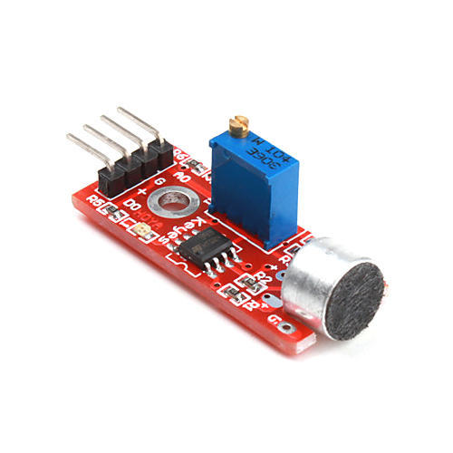
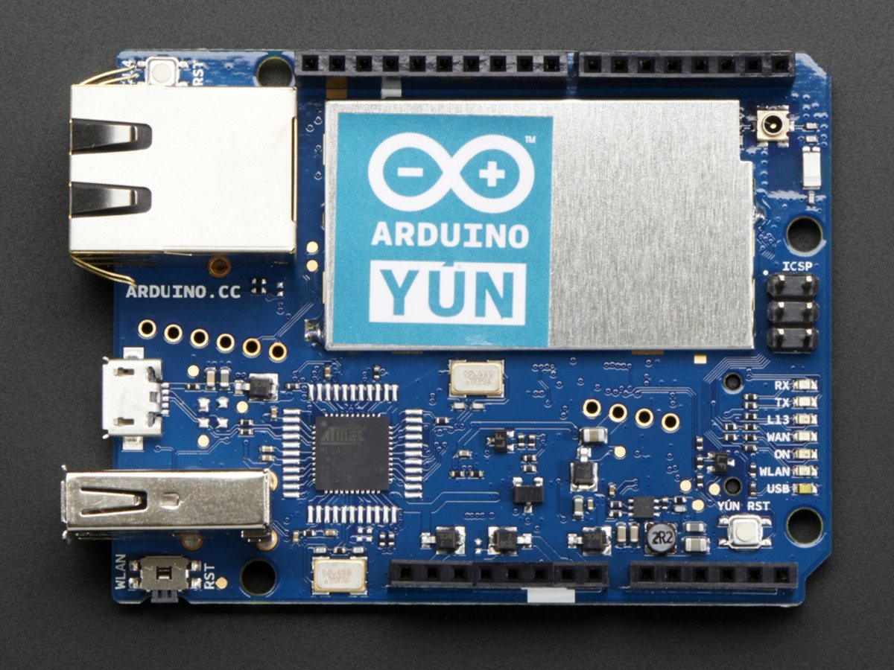
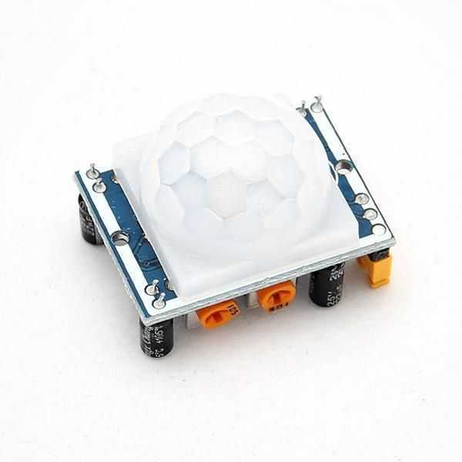
IoTArchitecture
Gets sound info every 0.5 s
Sends aggregated info every minute
Detailed user dashboard
KY-038
Sound Sensor
Arduino Yun
Web Interface
Cloud Service
NodeJS App Working on
DigitalOcean Droplet
Gets motion info every 0.5 s.
Saves entities to db
Reads entities from db
HC-SR501
PIR Motion sensor
Data Storage / Aggregation
MongoDB
BabyWatch
CMPE 490
Umut Barış Öztunç | Umut Baran Zorlu | Mehmet Çalım

Slide 5
Component | Name, if using 3rd party solution | Action (integration/ development/ configuration) briefly explain, if development and configuration | Expected Challenge
Sound Sensor | KY-038 | Integration | Environment sounds may be confusing.
PIR Motion Sensor | HC-SR501 | Integration | Environment actions may be confusing.
Wireless Connectivity | WIFI | Integration(on Arduino Yun) | Poor WIFI connection may cause data loss.
Embedded HW Platform | Arduino Yun | Integration | Low memory capacitance
Embedded HW App | Arduino Ide | Development(We set input and output pins. In addtition, we wrote some functions to handle data stream.) | Insufficient error description and lack of coding shortcuts.
Cloud Platform | Digital Ocean | Integration | Potential cloud service problems
Cloud App SW | Node.JS | Development(We implemented backend side of Cloud with Node.JS) | Understanding backend architecture may be challenging.
Web Client SW | Material Dashboard with Javascript and HTML | Development(We used Material Dashboard and Bootstrap Library) | Improvement of UI features may be challenging.
BabyWatch
CMPE 490
Umut Barış Öztunç | Umut Baran Zorlu | Mehmet Çalım

Slide 6

Challenges
Sensor sentivities were hard to configure to make data stream efficient.
Embedded Arduino Yun component sometimes lost WIFI connection.
Specifying a predefined sound threshold was hard in a noisy environment.
BabyWatch

Slide 7
Learnings
Integration of Arduino and varios sensors.
Developing a complete IoT project.
Efficient time and development management.
Benefits of team work.
BabyWatch
CMPE 490
Umut Barış Öztunç | Umut Baran Zorlu | Mehmet Çalım

